Slide 1
Sinister Transistor
By Greg Kelso, Mark Boutwell, Joel Gardyasz

Slide 2
Sinister Transistor
What is it?
2D game (similar to Legend of Zelda)
Player is a transistor
Fight off resistors and capacitors
Laplace Transform to become powerful

Slide 3
Sinister Transistor
Why?
We were interested in game design
Wanted to put our own take on a game

Slide 4
Sinister Transistor
There are many similar games out there
But none with an evil transistor
Fills the need of people wanting games where they can fight against resistors

Slide 5
Functional Requirements
The player shall be able to move up, down, left, and right, unless stopped by a wall.
The software shall feature music and sound effects.
The player shall be able to navigate into other areas and rooms in their environment. These rooms shall load and open once the player has indicated their desire to enter.
The player and enemies shall have a set amount of health. If this is depleted, the player/enemy shall die. If the player dies the game shall end.

Slide 6
Interface requirements
The user shall be able to start a new game.
The player shall be able to pause the current game to pull up a pause menu.

Slide 7
Physical environment requirements
The application shall run on a PC using the latest version of either Windows, OSX, or Linux
The application should support keyboard and mouse input

Slide 8
User and human factors requirements
The game shall support users of all skill levels and of all ages.
The game shall accommodate all players by having an ability to increase or decrease audio and font size.
The software should be bug free. The game should not let users exploit bugs to cheat and achieve a higher score.

Slide 9
Documentation requirements
The player shall be able view a manual consisting of game features and mechanics.
All game documentation shall be put online for the users to explore all aspects of the game and its design and implementation.

Slide 10
Data requirements
Entity Controllers shall store all relevant data to the object it is attached to.
Unity built-in functions shall be used when relevant.

Slide 11
Resource Requirements
The system shall require no more than three software engineers to complete the project.
The project shall be completed with Unity2D, coded in C#, and managed with Git version control.
The project, along with its required documentation and presentation brief, shall be completed no later than 11 April 2016.
The project shall be completed with only free software engineering tools.
The overall size of the project, including necessary documentation, shall take no more than 1GB of memory.

Slide 12
Security Requirements
The system shall remain secure during development.
The system shall be stored and version controlled using Git.
The system shall execute as a standalone application for Windows, OS X, and Linux devices.

Slide 13
Quality Assurance Requirements
The system shall be readable to all speakers of the English language.
The system shall minimize the required time to test.
The user shall meet the minimum Unity System Requirements in order to play the video game.

Slide 14
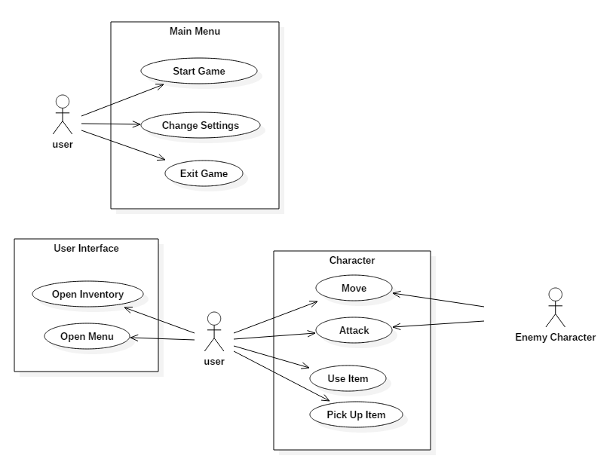
Use case diagram

